Slide 1
Math 152 – Lesson 2
Lesson | Topic | Reading | Homework
M1 | Antiderivatives | 4.9 | 23,25
M2 | Areas & Distances | 5.1 | 2,13
M3 | The Definite Integral | 5.2 | 5,8
Upcoming Suspenses
25 Aug | Derivative Review (WeBWorK)
27 Aug | FSPA #1 (WeBWorK)
27 Aug | FSQ #1

Slide 2
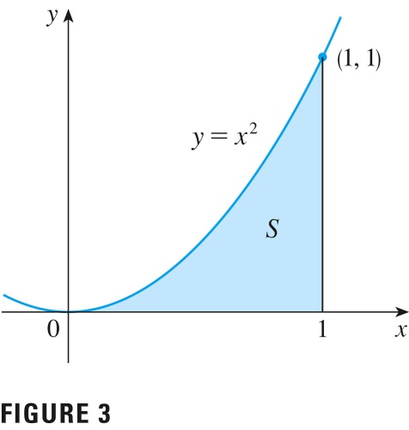
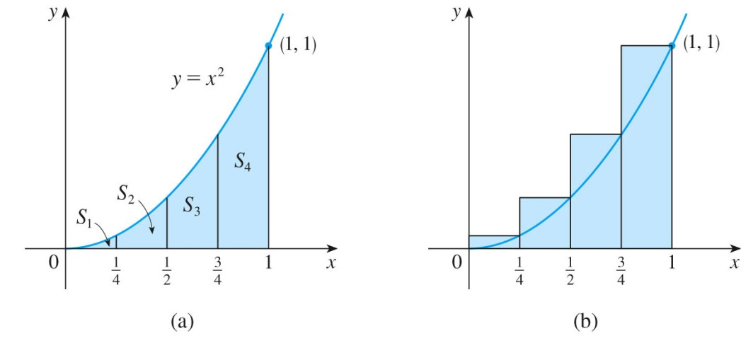
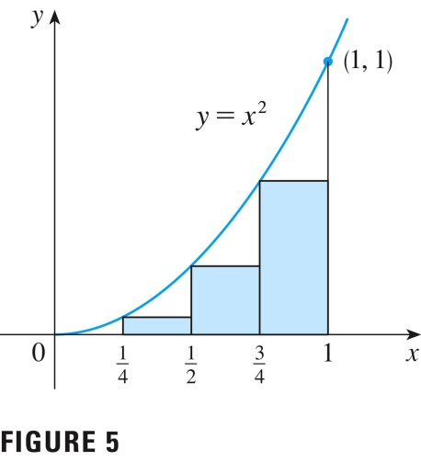
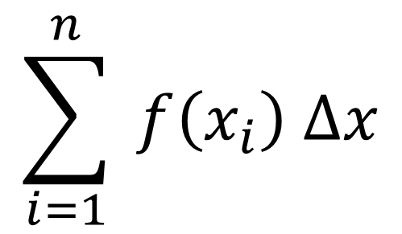


Estimating Area Under a Curve
Use rectangles to estimate the area under the parabola y = x² from 0 to 1.
${RHS}_{4}= \frac{1}{4}{\left(\frac{1}{4}\right)}^{2}$+$\frac{1}{4}{\left(\frac{1}{2}\right)}^{2}\text{+} \frac{1}{4}{\left(\frac{3}{4}\right)}^{2}$+$\frac{1}{4}{\left(1\right)}^{2}=\frac{15}{32}=0.46875$
$$\sum_{i=1}^{n}{ f\left(x_{i}\right) ∆x}$$
${LHS}_{4}=\frac{1}{4}{\left(0\right)}^{2}+\frac{1}{4}{\left(\frac{1}{4}\right)}^{2}$+$\frac{1}{4}{\left(\frac{1}{2}\right)}^{2}\text{+} \frac{1}{4}{\left(\frac{3}{4}\right)}^{2}=\frac{7}{32}=0.21875$

Slide 3
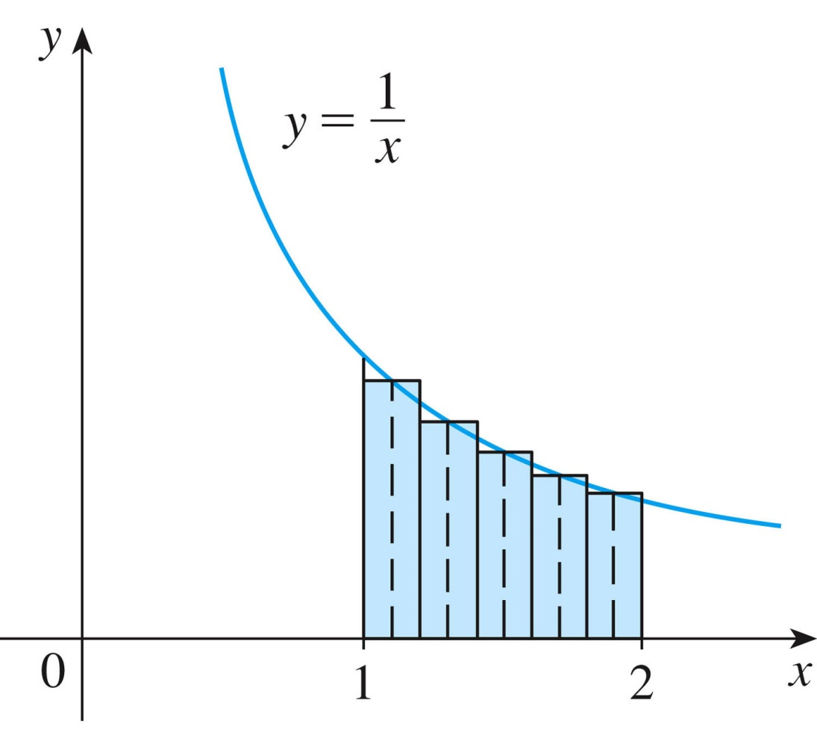
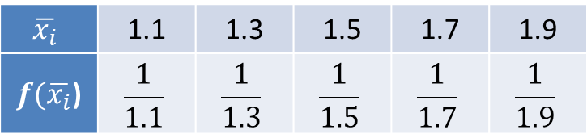
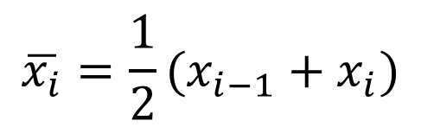
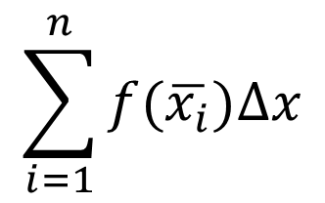
Midpoint Rule
$$\sum_{i=1}^{n}{f(\overline{x_{i}})∆x}$$
$$\overline{x_{i}}=\frac{1}{2}(x_{i−1}+x_{i})$$
$$\overline{x_{i}}$$ | 1.1 | 1.3 | 1.5 | 1.7 | 1.9
$f(\overline{x_{i}}$) | $$\frac{1}{1.1}$$ | $$\frac{1}{1.3}$$ | $$\frac{1}{1.5}$$ | $$\frac{1}{1.7}$$ | $$\frac{1}{1.9}$$
Notes:
Answer is 0.691908
Emphasize that you CAN’T interpolate if data is tabular

Slide 4
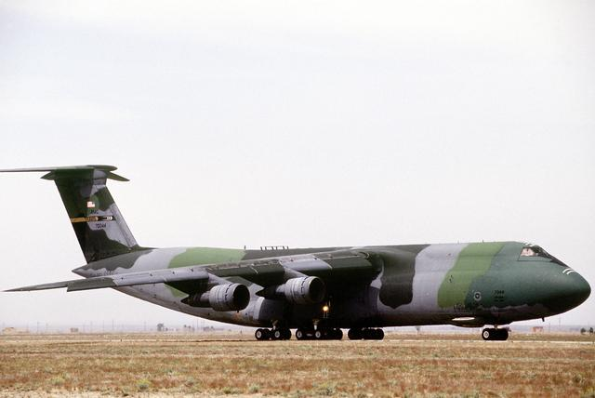
C-5 on Takeoff Roll

Slide 5
C-5 on Takeoff Roll
- Aircraft's velocity given by:
t, (sec) | 0 | 7 | 14 | 21 | 28 | 35 | 42
v, (ft/sec) | 0 | 41 | 78 | 113 | 145 | 173 | 200
-- Aircraft starts takeoff roll from the beginning of the runway
-- Runway is 5200 feet long
-- At 42 sec aircraft takes off
-- Aircraft velocity is increasing
Determine:
(a) Lower estimate for total distance traveled during first 42 seconds of the takeoff roll.
(b) Upper estimate for the total distance traveled during first 42 seconds of the takeoff roll.
(c) Did aircraft takeoff before reaching the end of the runway?

Slide 6
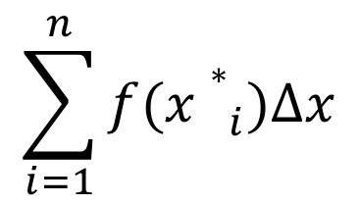
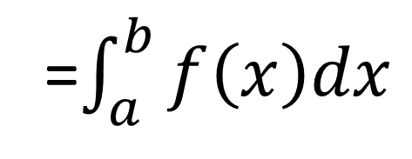
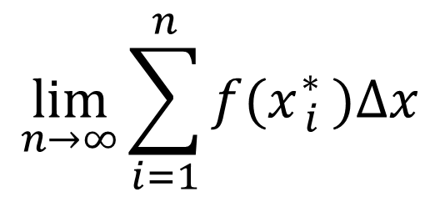
Riemann Sums
The estimations we’ve seen are called Riemann Sums and take the form:
$$\sum_{i=1}^{n}{f({x∗}_{i}^{})∆x}$$
Regardless of which type of Riemann sum we use, we’ll get better estimate as we let the number of subintervals get larger.
How do we find the exact area under the curve?
$$\lim_{n→∞}{\sum_{i=1}^{n}{f(x{}_{i}^{∗} )∆x}}$$
=$\int_{a}^{b}{f\left(x\right)dx}$
Notes:
Answer is 0.691908
Emphasize that you CAN’T interpolate if data is tabular

Slide 7
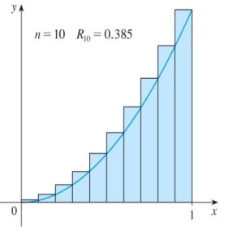




Definition of Definite Integral
The area beneath a curve can be approximated to within any desired degree of accuracy by a Riemann sum.
Suppose $f$ is continuous for $a≤t≤b$. The deﬁnite integral of $f$ from $a$ to $b$ is written as
The definite integral is the limit of the left-hand or right-hand sums with $n$ subdivisions of $a≤t≤b$ as $n$ goes to infinity.
Differential
$$\int_{a}^{b}{f\left(x\right)dx}$$
$$=\lim_{n→∞}{\sum_{i=1}^{n}{f(x{}_{i}^{∗} )∆x}}$$
Limits of Integration
Integrand

Slide 8
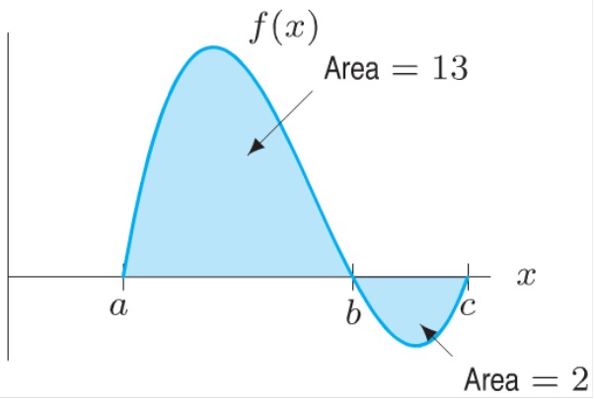

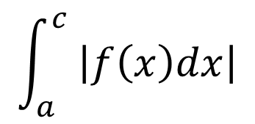


Definite Integral
A definite integral can be interpreted as a net area or the difference of areas
Calculate the following definite integrals:
$$\int_{a}^{b}{f\left(x\right)dx}$$
$$\int_{a}^{c}{f\left(x\right)dx}$$
$$\int_{b}^{c}{f\left(x\right)dx}$$
$$\int_{a}^{c}{ \left|f\left(x\right)dx\right|}$$
Notes:
Try these cold before next slide

Slide 9
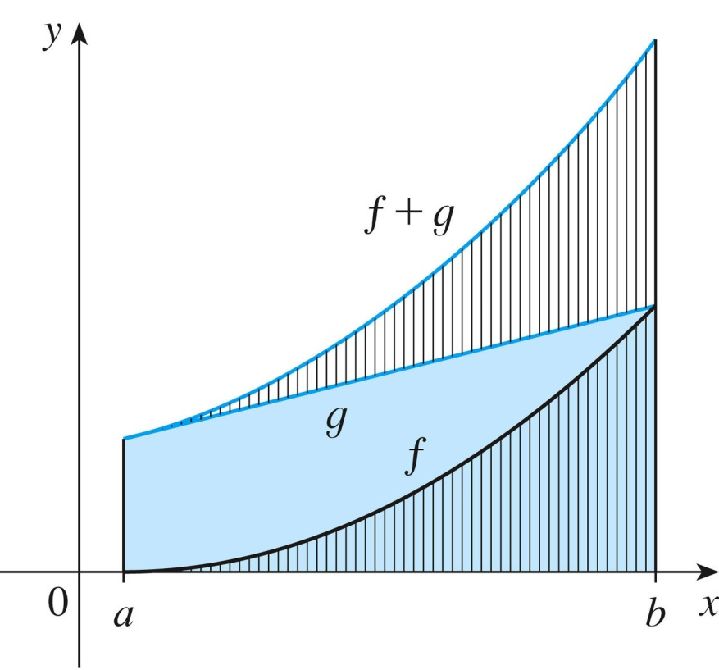
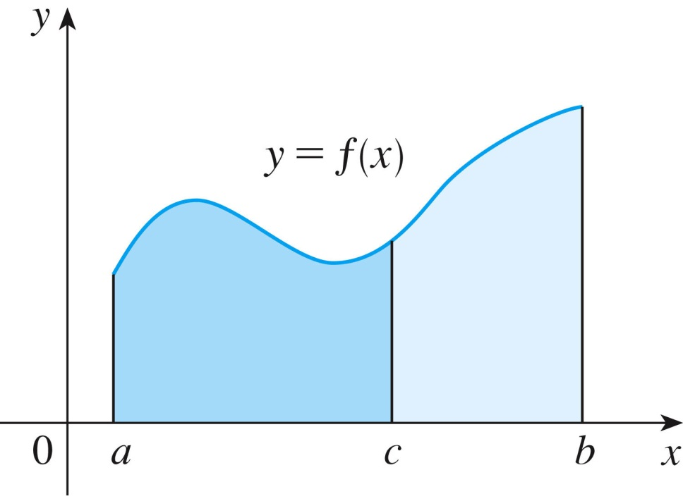
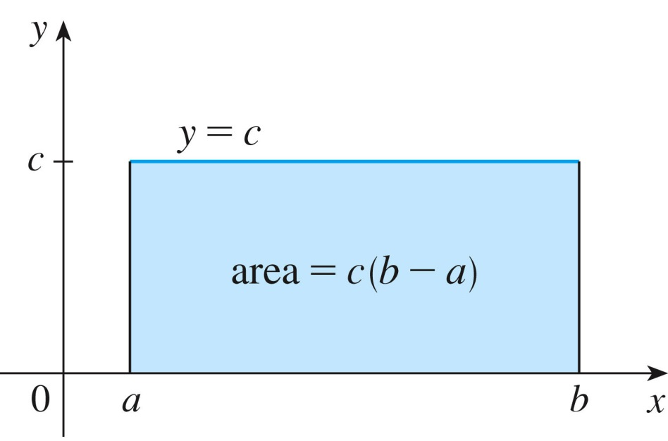
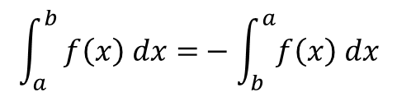
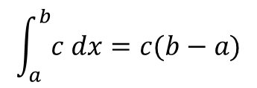
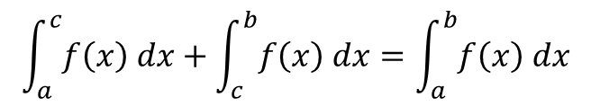
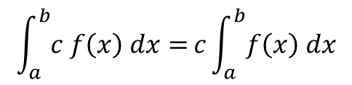
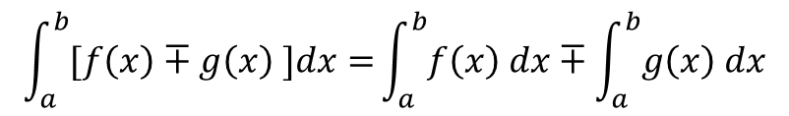
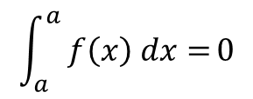
Integral Properties (pg379)
$$\int_{a}^{b}{[f\left(x\right)∓g\left(x\right) ]dx=}\int_{a}^{b}{f\left(x\right) dx}∓\int_{a}^{b}{g\left(x\right) dx}$$
$$\int_{a}^{b}{c f\left(x\right) dx=}c\int_{a}^{b}{f\left(x\right) dx}$$
$$\int_{a}^{b}{c dx=c(b−a)}$$
$$\int_{a}^{b}{ f\left(x\right) dx=}−\int_{b}^{a}{f\left(x\right) dx}$$
$$\int_{a}^{a}{ f\left(x\right) dx=}0$$
$$\int_{a}^{c}{f\left(x\right) dx}+\int_{c}^{b}{f\left(x\right) dx}=\int_{a}^{b}{f\left(x\right) dx}$$

Slide 10
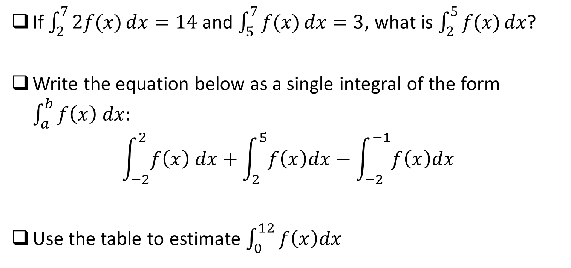
Seat Work
If $\int_{2}^{7}{2f(x)}dx=14$ and $\int_{5}^{7}{f(x)}dx=3$, what is $\int_{2}^{5}{f(x)}dx$?
Write the equation below as a single integral of the form $\int_{a}^{b}{f\left(x\right) dx}$:
$$\int_{−2}^{2}{f\left(x\right) dx}+\int_{2}^{5}{f\left(x\right)dx}−\int_{−2}^{−1}{f\left(x\right)dx}$$
Use the table to estimate $\int_{0}^{12}{f\left(x\right)dx}$
x | 0 | 3 | 6 | 9 | 12
f(x) | 32 | 22 | 15 | 11 | 9
Notes:
Ask about midpoint on second problem

